Slide 1
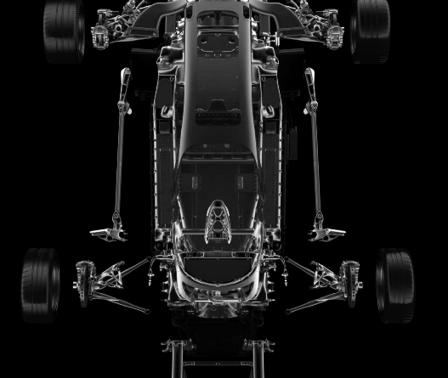
Capstone Project : Automotive Industry
Group B-3 Aman Bhardwaj Priya Bhardwaj Tanisha Jain Satyam Sharma Suneeta Vemula

Slide 2
Content
Problem Statement Discussion
Challenges
Task 1
Next Steps
Task 1.1
Task 1.2
Task 1.3

Slide 3
Problem statement
XYZ company aspires to enter the US used car market
Based on the dataset of different types of used cars across the market:
List the output of exploratory analysis.
Highlight important outcomes/findings from the data by descriptive analysis.
Build an appropriate predictive model for predicting the price of a used car.

Slide 4
Challenge
Problem faced by the Company
The XYZ Company want to understand the factors affecting the pricing of cars in the market, since those may be very different from the new car market. Essentially, the company wants to know:
Which variables are significant in predicting the price of a used car?
How well those variables describe the price of a car?

Slide 5
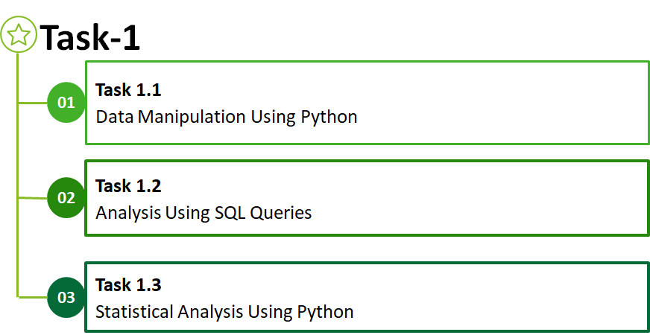

Slide 6

Data Manipulation Using Python

Slide 7
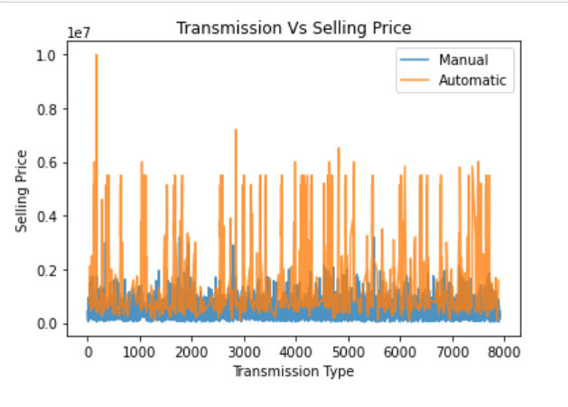
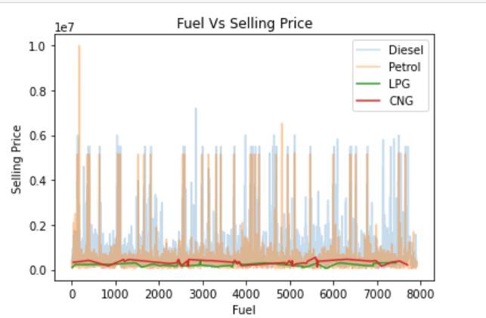
Which variables are significant in predicting the price of a used car?
Using various data manipulation method using python to understand the variables which are significant in predicting the price of a used car

Slide 8
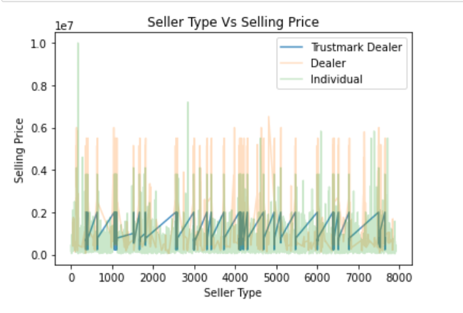
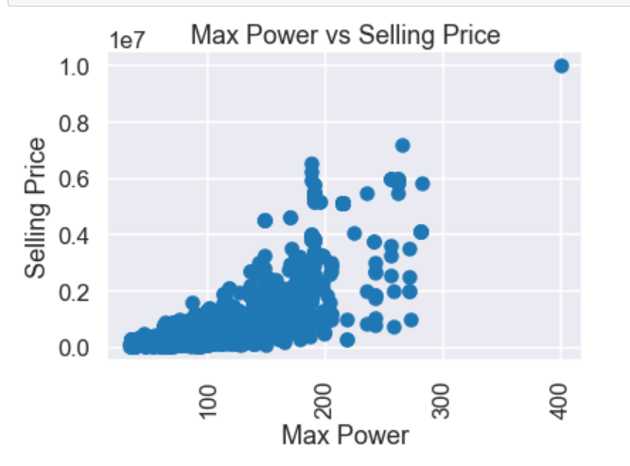
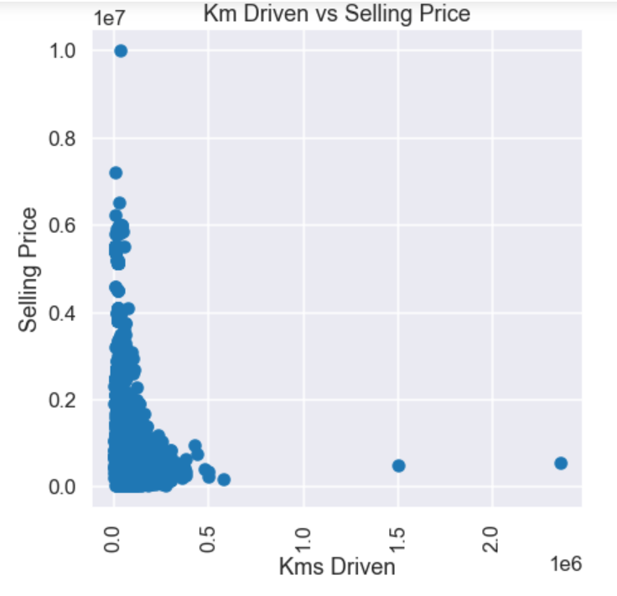
Other variables that are significant in predicting the price of used car.

Slide 9
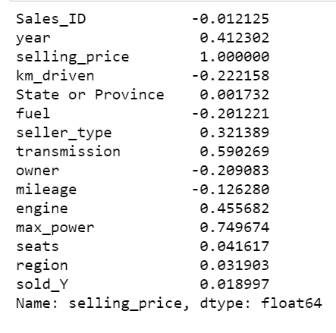
How well the variables describe the price of a car?
Coefficient of correlation is an extensively used mathematical method in which the numerical representation is applied to measure the level of relation between linearly related variables.
In the data correlation along side, we can see that max power, engine(volume), year(of manufacturing) and transmission type have a positive increase in the selling price of the car and the values indicating a good correlation.
The other attributes namely kilometer driven, and owner type have negative effect on the selling price and the values indicating has low correlation

Slide 10
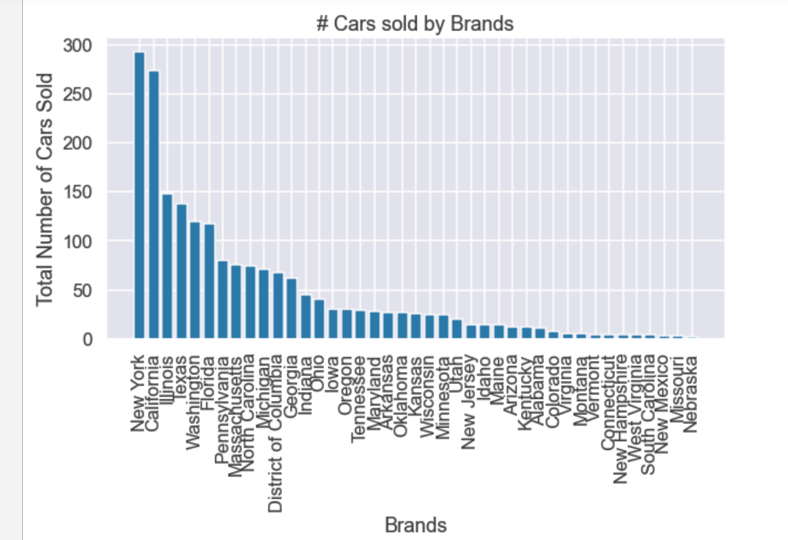
Which brands are selling the most?

Slide 11
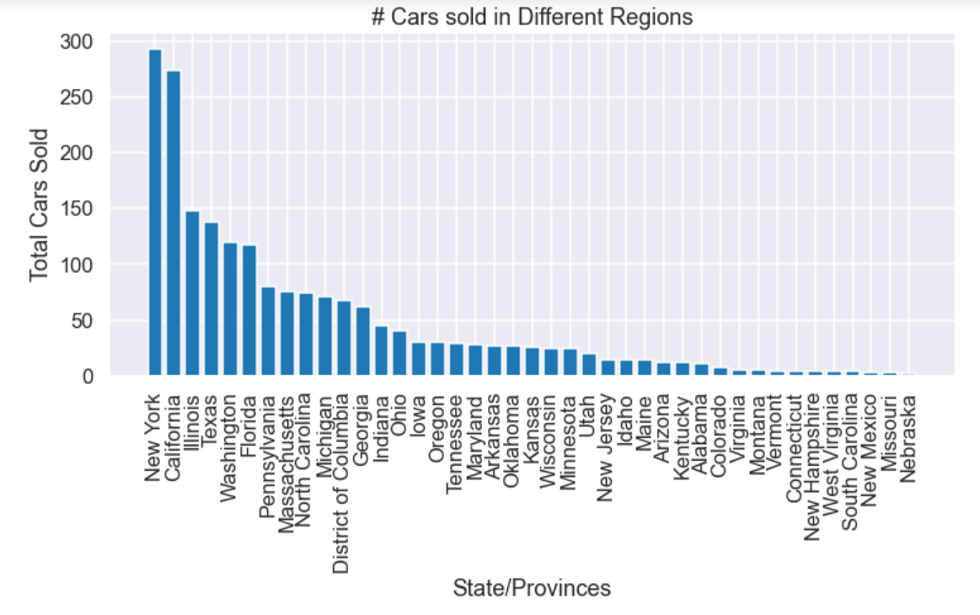
Specific locations selling more

Slide 12

Analysis using SQL Queries

Slide 13
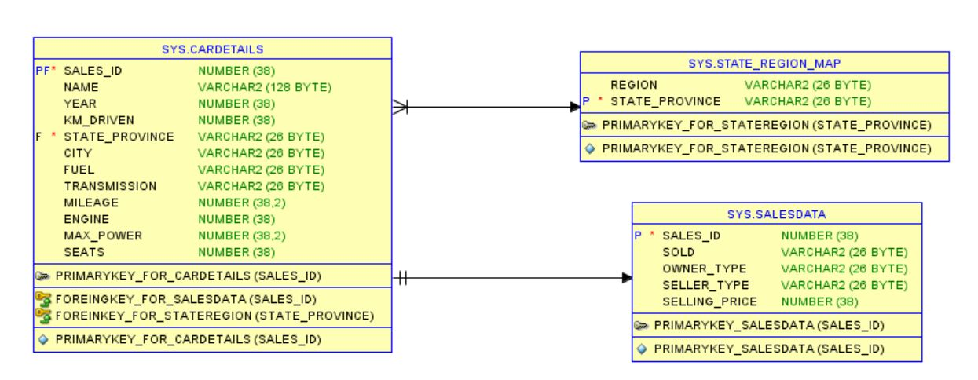
ER Diagram

Slide 14
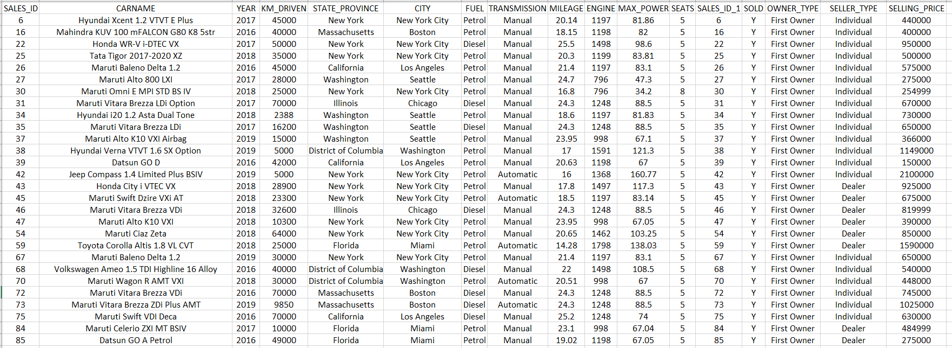
SQL Query 1
Generate Info of the cars which is of the type first owner and the year of car purchase is between 2016-2020 and the number of kms driven is less than 80,000
1

Slide 15
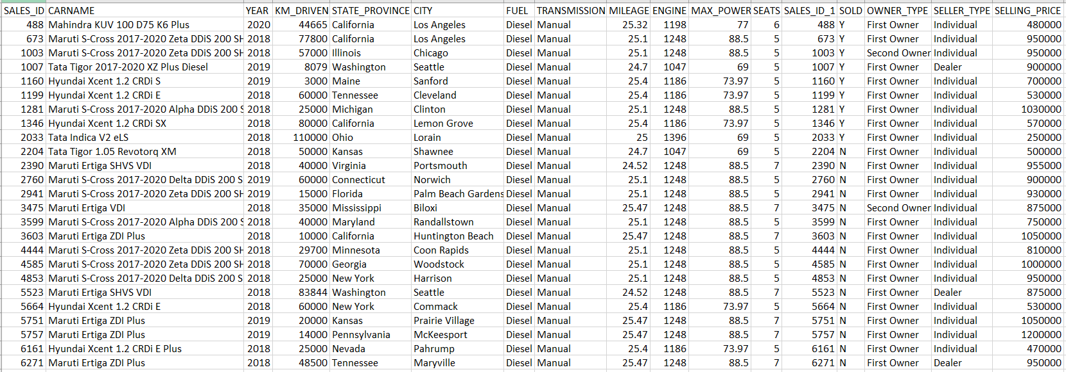
SQL Query 2
Generate Info of all the cars whose average mileage is around 25 kmpl and year of car purchase is between 2018-2020 which has minimum seating of 4-5 and fuel type is diesel.

Slide 16
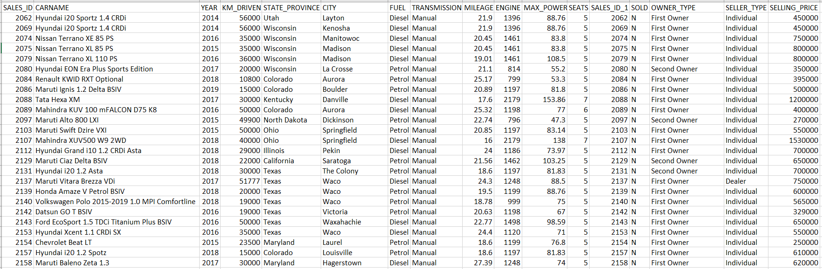
SQL Query 3
Generate Info of all the cars which are not sold, and seller-type is individual or dealer and also which has been used for less than 60000 kms and year of car purchase is 2014-2020.

Slide 17
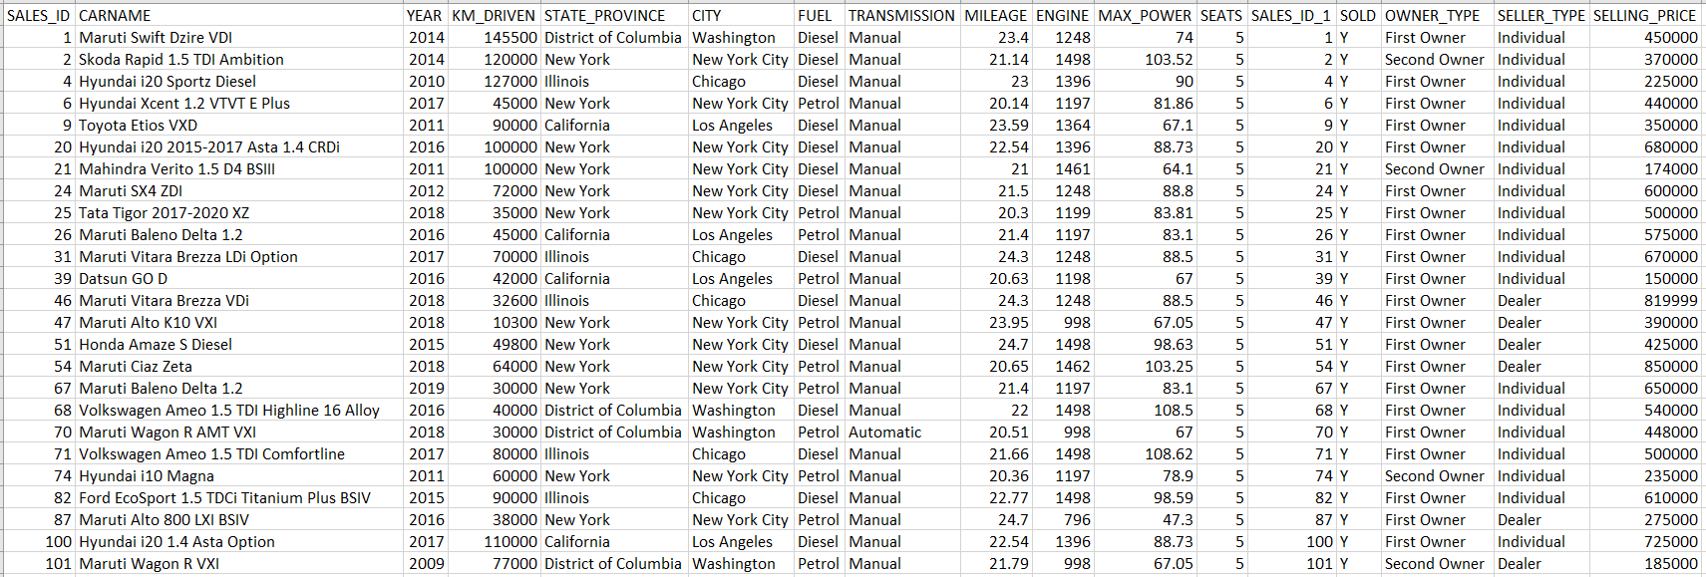
SQL Query 4
Generate Info of all the cars which are manual and automatic whose mileage ranges between 20-25kmpl approximately and also which is within these cities(Washington, New York City, Chicago, Los Angeles)

Slide 18
SQL Query 5
Generate Info of all the cars which belong to Honda category could be either first owner and second owner and also fuel type is petrol and average mileage should be 25 kmpl and which are not sold and seating arrangement should be minimum 4.
No output matching the above constraints.

Slide 19
Statistics using Python

Slide 20
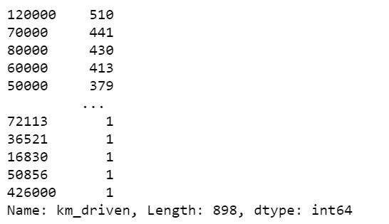
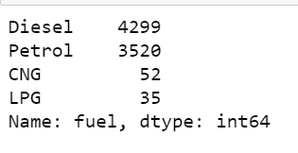
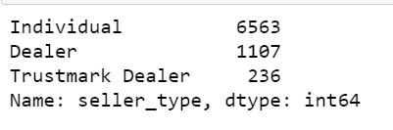
Descriptive Analysis
For Kilometer Driven
For Fuel Type
Similarly analyzed for other attributes.
Conclusion:
Discrete/Categorical Year, State or Province, Seller Type, Seats, Brands, Sold
Continuous Kilometer driven, Mileage, Engine(Size), Max Power
For Seller Type

Slide 21
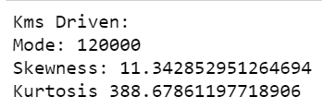
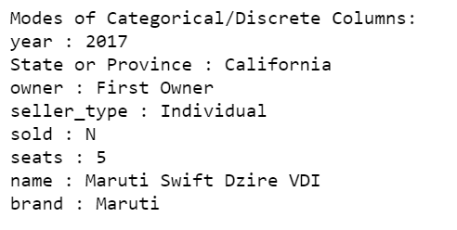
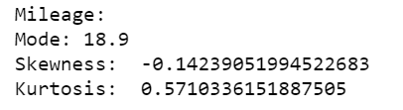
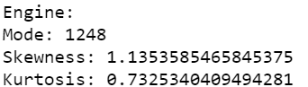
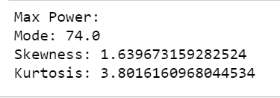
Mode, skewness and Kurtosis
For Continuous Attributes
For Categorical Attributes

Slide 22
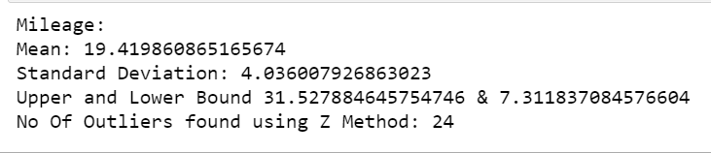
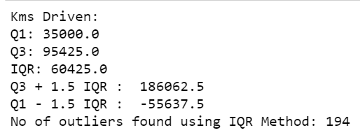
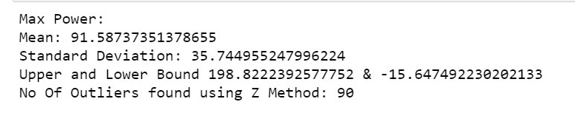
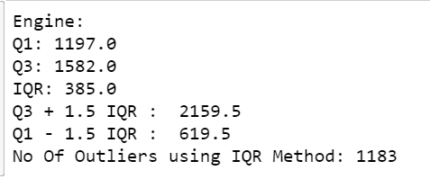
Outlier Analysis
Using Z Score Method
Using IQR Method
For Mileage
For Kilometer Driven
For Max Power
For Engine

Slide 23
Hypothesis Testing(Z-Test)
Using Z-Test on the Brand to see whether the assumed null hypothesis is valid.
H0: Maruti accounts for 30% of the cars sold. H1: Maruti does not account for 30% of the cars sold.
P-Value = 0.8834. Since the p-value is greater than the level of significance(α=0.05) we accept the null hypothesis.

Slide 24
Hypothesis Testing(Chi-Square Test)
Chi-Square test on Region and Year of the already sold cars to find if the two attributes have association
H0: Region and Year for already sold cars have no association. H1: Region and Year for already sold cars have no association.
P-Value = 0.6115. Since p-value is not close to 0 we accept the null hypothesis.

Slide 25
Roadmap
1st Week
3rd Week
5th Week
7th Week
Understanding the Data Domain and Data Set and using Python for Data Manipulation
Data Visualization using Python and EDA
Model Building using Machine Learning
Testing and Data Analysis on Cloud
2nd Week
4th Week
6th Week
8th Week
Analysis using SQL and Python for Statistics and Hypothesis Testing
Visualization using Power BI and Model Building using Machine Learning
Review the ML Algorithms and Data Analysis using Big Data Tools
Deployment of Models using Flask
Present Checkpoint

Slide 26
Project Repository

Slide 27
Thank you

